Slide 1
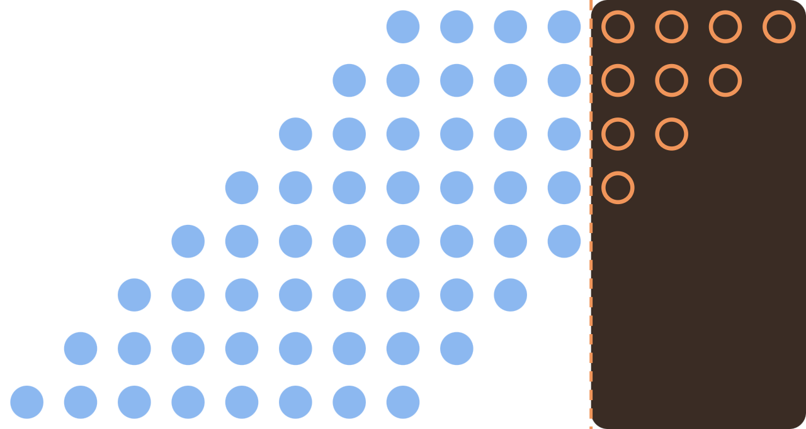
AxMAC
AI ACCELERATORS · IIIT DHARWAD · MILESTONE 1 REVIEW
A precision-scalable approximate MAC accelerator with open-source ASIC characterization
Durgesh Janapareddy
Sairam Kesanapalli
github.com/durgeshjanapareddy9-collab/PSAMAC-Accelerator
Notes:
Hello everyone. We are presenting AxMAC, our AI Accelerators course project, and this is the Milestone 1 review: what we built up to the October 1 deadline. In one line: an 8x8 multiplier whose accuracy is a single dial, N, and an open-source flow that measures what each setting of the dial costs and saves. The dots on the right are the 64 partial products of the multiplier; the hollow orange ones are the bits we throw away when N = 4.

Slide 2

One multiplier, one accuracy dial: N
WHAT ARE WE DOING · WHY
What we are building
CNN inference is mostly multiply-accumulate
a[7:0]
approx_mul #(N)
Every convolution and fully-connected layer repeats the same MAC operation, so the multiplier's cost is multiplied too.
8×8 Dadda tree
p[15:0]
b[7:0]
Approximation trades accuracy for hardware
N = 0: exact
N = 12: smallest, least exact
Approximate multipliers give up a little accuracy to save area and power, or to run faster.
N is a compile-time parameter: the lowest N columns of partial products are dropped. Then we measure how much error each N causes, and how much area, delay and power it saves.
A dial instead of a few fixed designs
Published designs usually offer a few fixed accuracy points. A dial lets you pick the point your application can afford.
AxMAC · Milestone 1
2
Notes:
What we are doing: an 8x8 unsigned multiplier, a and b in, a 16-bit product out, with one compile-time parameter N. N = 0 is the exact multiplier. As N grows, we drop more of the low-order partial products, so the circuit gets smaller and less accurate. Why: CNN inference is dominated by multiply-accumulate operations, so whatever the multiplier costs, you pay it millions of times. Approximate multipliers trade a little accuracy for area, power or speed. But published designs usually give you only a few fixed accuracy points. A single dial lets a designer choose exactly how much accuracy to give up.

Slide 3
The gap we are filling
WHAT IS THE GAP · HOW WE FILL IT
CLOSELY RELATED WORK
THE GAP
WHAT WE DO
Rather et al. 2025: two FPGA design points. X-Dadda: approximate width is one knob among several.
Only a few points on the accuracy vs cost curve
One parameter N covers the whole truncation range: a full sweep, N = 0 to 12 (13 designs).
Rather et al. observed that image quality tracks EDmax and how often it occurs, not just MED/NMED.
One study's observation, worth a systematic test
Test it: our sweep plus EvoApproxLib/TruMD baselines, image and CNN workloads, rank correlation.
Hardware numbers depend on the tools, process and flow used to get them.
Numbers anyone can re-run themselves
Fully open ASIC flow: Yosys + OpenSTA on SkyWater 130 nm; every number comes from a script.
"The multiplier architecture, a Dadda tree with truncated low-order columns, is existing prior art. Our contribution is the parameterization, the open-flow characterization and the evaluation framework." Parameterized approximate multipliers themselves are not new (X-Dadda, TPU-Gen).
AxMAC · Milestone 1
3
Notes:
Read this table left to right, one row at a time. Row 1: Closely related work reports only a few design points. Rather et al. 2025 has two FPGA designs; X-Dadda treats approximate width as one knob among several. We sweep the whole range with one parameter N. Row 2: Rather et al. observed that image quality follows the maximum error and how often it occurs, not just the mean error. We want to test that systematically: many designs (our sweep plus published baselines), two workloads, and a rank-correlation analysis. That is Milestone 2 work. Row 3: We use a fully open toolchain, so anyone can regenerate every number. Be clear about what is NOT ours: truncated Dadda multipliers are prior art, and parameterized approximate multipliers already exist (X-Dadda, TPU-Gen). Our contribution is the parameterization, the open-flow characterization and the evaluation framework.

Slide 4
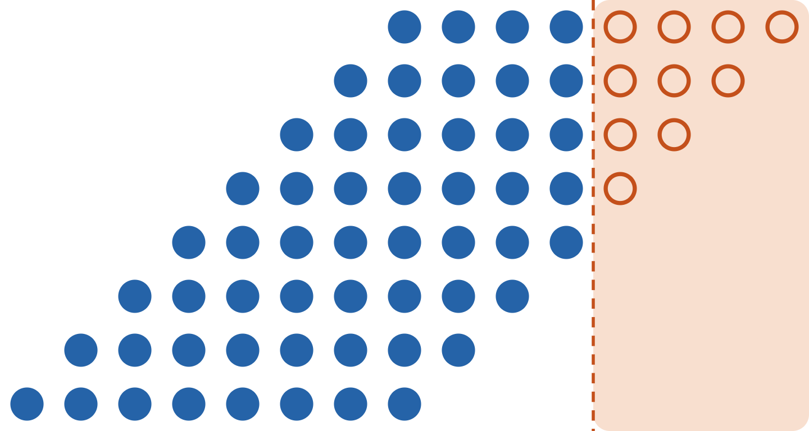
Drop the lowest N columns, keep the rest
HOW ARE WE DOING IT · THE DESIGN
1 · Partial products
pp(i, j) = a[j] AND b[i], worth 2^(i+j). 64 bits, grouped into 15 columns.
2 · Truncate
If i + j < N, the bit is a constant 0. The result can only get smaller, never larger.
3 · Dadda tree
35 full + 7 half adders squeeze the columns to heights 6, 4, 3, 2; a final + adds the last two rows.
← column 14 (weight 2^14)
column 0 (2^0) →
Solid blue = kept bit. Hollow orange = dropped (column i + j < N). Shown: N = 4, which drops 10 of the 64 bits.
4 · Synthesis cleans up
Adders fed only by zeros are removed by constant propagation. The tree is not re-planned for each N.
AxMAC · Milestone 1
4
Notes:
Multiplying two 8-bit numbers produces 64 one-bit partial products: bit j of a AND bit i of b, worth 2 to the power i+j. Bits with the same i+j form a column; the diagram shows all 15 columns, with the least significant on the right. Our knob: every bit in the lowest N columns is replaced by a constant 0. Here N = 4, so the ten hollow orange bits are gone. Because we only remove value, the approximate product is never larger than the exact one. The remaining bits are added by a standard Dadda tree: 35 full adders and 7 half adders, generated by our script gen_dadda.py, then a normal adder for the last two rows. Important honesty point: we do not re-plan the tree for each N. We use the same tree and let synthesis delete adders whose inputs became constant zero. That is where the hardware saving comes from.

Slide 5

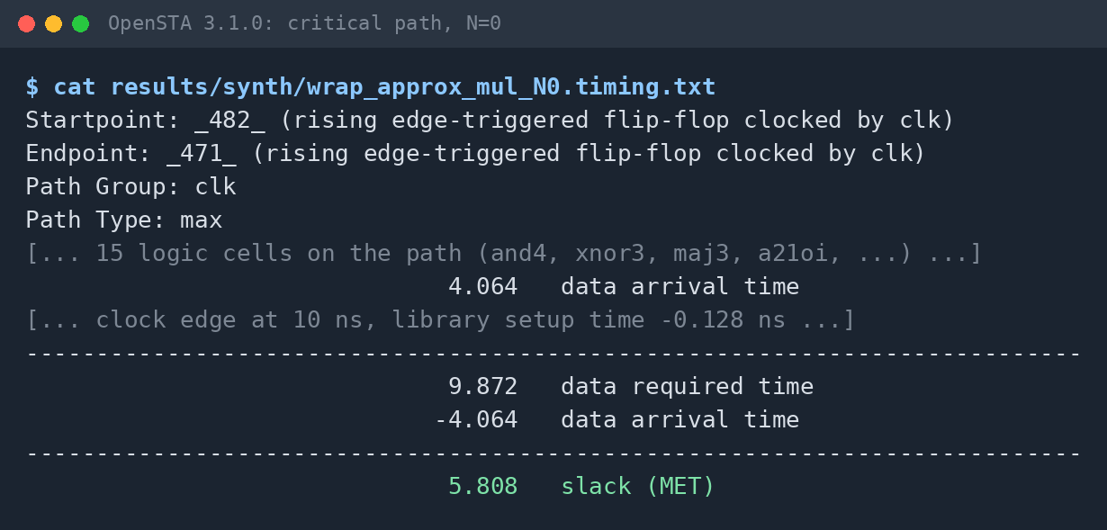
One open-source flow, one make command per step
HOW ARE WE DOING IT · THE FLOW
1 Generate
2 Verify
3 Synthesize
4 Time
5 Power
gen_dadda.py
Icarus 12
Yosys 0.33
OpenSTA 3.1.0
sim + OpenSTA
Plans the Dadda tree, writes its RTL
65,536 pairs × 13 N vs the Python model
sky130 standard cells → area
Critical path → minimum clock period
Gate-level activity → report_power
Reading the timing screenshot
4.064 ns logic delay + 0.128 ns flip-flop setup = 4.19 ns minimum clock period for the exact multiplier (N = 0).
Corner: sky130_fd_sc_hd, typical, 25 °C, 1.80 V. Pre-layout: no wire load, ideal clock.
Every number is written to results/ by a script; nothing is typed by hand.
AxMAC · Milestone 1
5
Notes:
This is the pipeline, and every box is one make command. 1. gen_dadda.py plans the Dadda tree, checks it in Python, and writes the Verilog. 2. We simulate the RTL in Icarus on all 65,536 input pairs for each of the 13 values of N, and compare with the Python model. 3. Yosys synthesizes it to SkyWater 130 nm standard cells and reports area. 4. OpenSTA finds the critical path. The multiplier sits between flip-flops, so the delay is register to register. 5. For power we simulate the synthesized gate netlist, record switching activity, and give it to OpenSTA's report_power. The screenshot is the real timing report for N = 0: the signal arrives after 4.064 ns, plus 0.128 ns setup time, gives a 4.19 ns minimum clock period, about 239 MHz. These are pre-layout numbers at the typical corner, so we only compare them relative to each other.

Slide 6
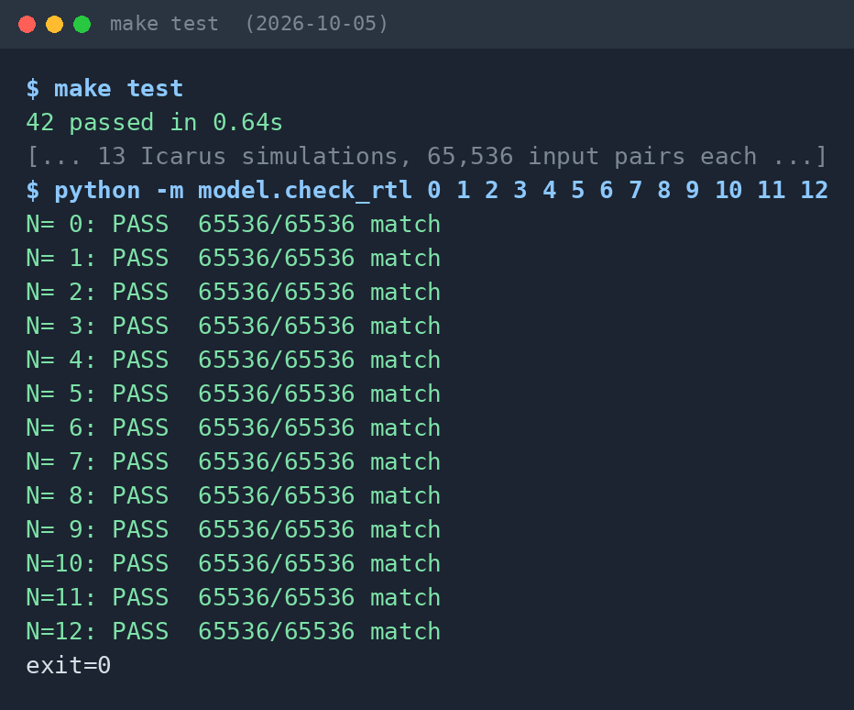
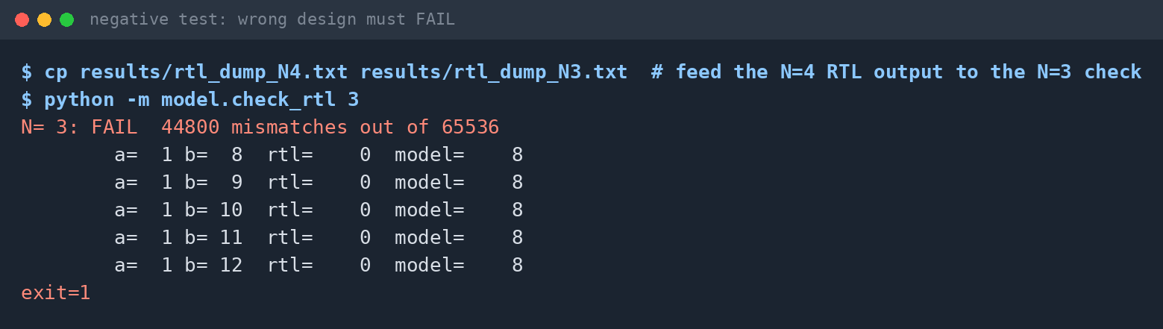
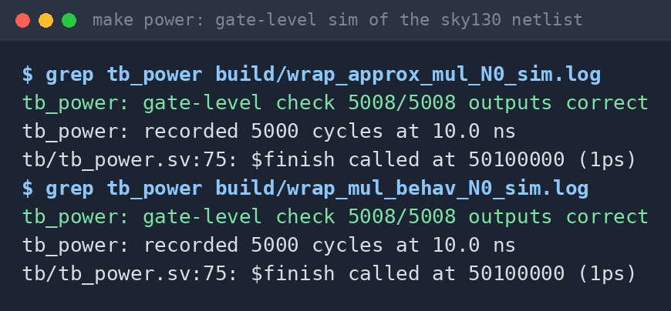
Verification: RTL = model on every input
VERIFIED TRUST · RE-RUN ON 5 OCT 2026
Can the checker fail? Given the wrong design (N = 4 output vs N = 3 model), it reports 44,800 mismatches.
After synthesis, the sky130 gate netlist still computes a × b: 5,008 / 5,008 outputs correct.
make test: all 13 values of N match on all 65,536 inputs, plus 42 model unit tests.
AxMAC · Milestone 1
6
Notes:
Why should you trust our numbers? Three pieces of evidence, all re-run on 5 October from the committed repo. Left: make test. It runs 42 unit tests on the Python model, then simulates the Verilog for every N from 0 to 12 on all 65,536 input pairs, and compares every single output with the model. 13 out of 13 pass, with zero mismatches. Top right: a test that passes no matter what proves nothing, so we checked that the checker can fail. We gave it the N = 4 hardware output but asked it to check against the N = 3 model. It reports 44,800 mismatches and exits with an error. (We restored the real dump file afterwards and it passes again.) Bottom right: after synthesis, we simulate the actual gate-level netlist built from sky130 cells and check every output against a times b: 5,008 out of 5,008 correct, for both our exact Dadda tree and the tool's own a*b.

Slide 7
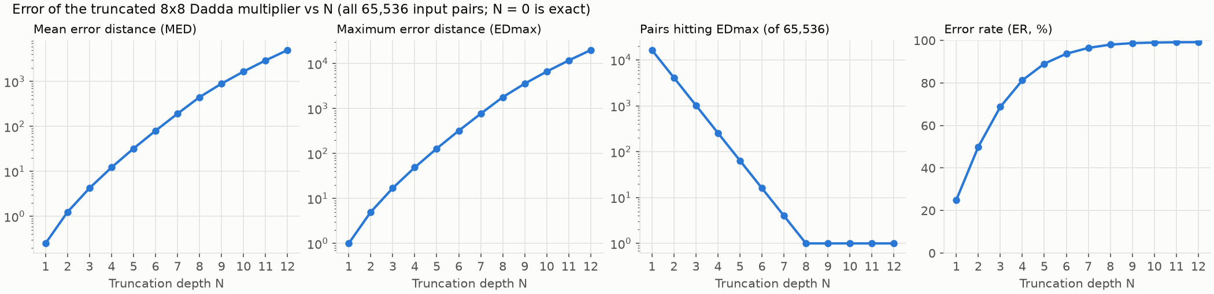
Milestone 1 results: error and area across N
WHAT WE HAVE FOUND SO FAR
−12.1% area
−54.8% area
−93.2% area
Exact, N = 0
N = 4 · MED 12.25
EDmax 49 (256 pairs)
N = 8 · MED 448
NMED 0.69%
N = 12 · MED 4,992
NMED 7.68%
vs Yosys a*b: a*b uses +8.2% area,
+5.8% power, is 2.4% faster
Area vs N = 0 · Yosys 0.33 + OpenSTA 3.1.0 · sky130_fd_sc_hd tt 25 °C 1.80 V · pre-layout
7
Notes:
Top: the error side, computed over all 65,536 input pairs by model/metrics.py. Mean error and maximum error both climb steadily with N. The third plot is the interesting one for our research question: the number of pairs that hit the maximum error drops by 4x per step, so for large N the worst case is very rare. Error rate saturates near 99%, because almost every product loses at least one bit. Bottom: the hardware side. Area falls with every N: 12% saved at N = 4, 55% at N = 8, 93% at N = 12. All area numbers are relative to our exact N = 0 design, from the same flow. Right card: our exact Dadda tree (N = 0) against the tool's own a*b. The a*b version needs 8.2% more area and 5.8% more multiplier power, and is 2.4% faster. Power used uniform random inputs, which the milestone plan allows; Milestone 2 switches to image data. One honest caveat: delay does not fall steadily with N. N = 2, 3, 4 and 7 come out slower than N = 0 even though they have less logic. That is a side effect of the synthesis tool mapping logic without a timing target, and we will test timing-driven mapping in Milestone 2.

Slide 8
Repository: every file has one job
HOW THE REPO IS STRUCTURED
rtl/ · the hardware
model/ · the Python reference
approx_mul.sv
multiplier; zeroes N columns
approx_mul.py
bit-exact model + LUT per N
dadda8_reduce.sv
generated tree: 35 FA + 7 HA
check_rtl.py
RTL dump vs model: PASS / FAIL
full/half_adder.sv
the two adder building blocks
metrics.py
ER, ME, MED, NMED, MRED, EDmax
mul_behav.sv
plain a*b, for comparison
tests/
42 pytest checks of the model
mul_wrap.sv
flip-flops around it (timing)
flow/ · synthesis, timing, power
tb/ · testbenches
config.mk
all tool and PDK paths
tb_approx_mul_exhaustive.sv
all 65,536 pairs → dump file
synth.tcl
Yosys → sky130 netlist + area
tb_power.sv
gate-level sim for power
sta/power.tcl
OpenSTA timing and power
scripts/ · helpers
ppa/power.py
run the flow, write the CSVs
gen_dadda.py
plans, checks, writes the tree
top level
md_tables.py
docs tables from results/
Makefile
one command per step
tool_versions.sh
records every tool version
results/ figures/
generated only, never hand-edited
docs/
milestone1.md, REFERENCES.md
Also in flow/: make_synth_lib.py (liberty copy without lpflow and probe cells) · README.md, PROGRESS.md
8
Notes:
The repo is organised by job. rtl holds the hardware: the approximate multiplier, the generated Dadda tree, the adder building blocks, a plain a*b for comparison, and a wrapper that puts flip-flops around a multiplier so we can measure timing. tb holds the testbenches: one applies all 65,536 input pairs, the other simulates the gate-level netlist to get switching activity for power. model is the Python reference: the bit-exact model and lookup tables, the checker, the error metrics and 42 unit tests. flow is synthesis, timing and power, with every tool path set in one file, config.mk. Finally, results and figures are only ever written by scripts, never by hand, and the Makefile has one command per step, so a clean clone reproduces everything.

Slide 9
Next: Milestone 2, due 29 October
WHAT CAN BE THE FUTURE RESULTS
We will build and run
Results we will report
MAC unit (24-bit accumulator) and a new 4×4 output-stationary systolic array, bit-exact vs a Python golden model
Baselines: 3–4 EvoApproxLib multipliers and TruMD, each verified, then run through the identical flow
Power with realistic stimulus: image pixels × kernel weights
Accuracy vs area, delay and power curves across N, with the baselines marked
Image filtering quality (PSNR, SSIM), including the Rather et al. cameraman case
CNN on MNIST (int8): change in top-1 accuracy
Which error metric best predicts quality loss: mean error, or EDmax and how often it occurs
Open issue from Milestone 1: delay does not fall steadily with N (the synthesis mapper has no timing target). We will test timing-driven mapping.
AxMAC · Milestone 1 · Thank you, questions?
9
Notes:
What comes next, for October 29. On the build side: a MAC processing element and a new 4x4 systolic array, both checked bit for bit against a Python golden model. Then the baselines: three or four published multipliers from EvoApproxLib, plus TruMD, each verified and pushed through exactly the same flow, wrapper, clock and corner as ours. And power measured with realistic image data instead of random numbers. On the results side we will produce: accuracy versus area, delay and power curves; image filtering quality in PSNR and SSIM, including the same noisy-cameraman case Rather et al. used so we can compare with them; the change in CNN top-1 accuracy on MNIST; and the main research question, a rank-correlation analysis of which error metric best predicts the quality loss. We are not predicting those numbers yet; they will come from the scripts. If we fall behind, the CNN is the first thing we cut; the baseline comparison stays. And one open issue we are honest about: delay does not decrease smoothly with N, which we will address with timing-driven mapping. Thank you, happy to take questions.

